Slide 1


Run Atomic Red Team!
Presented by:
Jesse Moore, Sr. Cybersecurity Advisor
UW Office of the CISO; UW Bothell
Resources: http://bit.ly/AtomicRedTeam
Notes:
Resources:
https://uwnetid-my.sharepoint.com/personal/moorej1_uw_edu/_layouts/15/onedrive.aspx?id=%2Fpersonal%2Fmoorej1%5Fuw%5Fedu%2FDocuments%2FShared%20with%20Everyone%2FCISO%20InfoSec%20Briefing%2F2020%5FOctober%5FAtomicRedTeam
Let's install and Run Atomic Red Team!

Slide 2

(Disclaimer)
WARNING…
The following presentation contains my thoughts, ideas and opinions. They do not represent those of my current or past employers.
Any events, characters and company depicted during this presentation are purely fictitious.
Any similarity to actual events, characters and company is merely coincidental. Like South Park!
Do not use these tactics/techniques presented for evil.

Slide 3

Together We Can Defend!
Security depends on US.
Yep, more stuff to do…
Notes:
This is for will help everyone
Managers sending this info to Admins

Slide 4
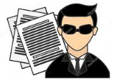
WHO Am I?
Previously:
Security Engineer in Threat Detection and Response Team @ UW Medicine
Systems Administrator @ Nintendo of America
Currently:
Sr. Cybersecurity Advisor @UW Bothell
Education:
Bachelors of Science IT Security
GIAC Penetration Tester | Forensic Analyst
https://www.linkedin.com/in/jessefmoore/
Notes:
System admin of AS/400, Linux, Windows, Mac machines and ensuring corp internal stuff (AD.Virus,DDOS) worked
As well as Nintendo.com, WiiShop to download games, DevOps, etc

Slide 5

Agenda
1. Red Canary -Atomic Red Team (ART)
2. Mitre ATT&CK
Notes:
Install and run Red Canary Atomic Red Team
However we will need to know a little about Mitre ATT&CK as its related.

Slide 6

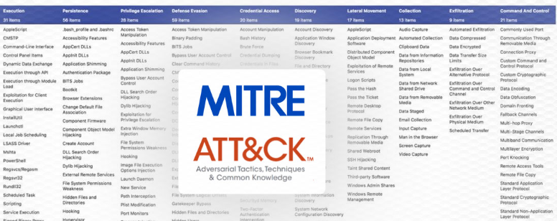
Mitre ATT&CK…
What exactly is that?
Reference: https://attack.mitre.org/
Notes:
https://attack.mitre.org/
A group of Adversary Tactics, Techniques
We will tour the Mitre ATTACK enough to see their Tactics ID
Let go to the Matrics

Slide 7
Here are my ART Github Merges
Kill EventLog Service Threads = https://attack.mitre.org/techniques/T1562/002/
LOLB -WinDefend to download file = https://attack.mitre.org/techniques/T1105/
Enable Guest account = https://attack.mitre.org/techniques/T1078/001/
Windows built-in Packet trace = https://attack.mitre.org/techniques/T1040/
Brute Force: Password Cracking -Hashcat = https://attack.mitre.org/techniques/T1110/002/
Notes:
SEE MITIGATIONS Section, very useful.
Kill EventLog Service Threads = https://attack.mitre.org/techniques/T1562/002/
https://artofpwn.com/phant0m-killing-windows-event-log.html
https://www.ired.team/offensive-security/defense-evasion/disabling-windows-event-logs-by-suspending-eventlog-service-threads
LOLB -WinDefend to download file = https://attack.mitre.org/techniques/T1105/
https://github.com/redcanaryco/atomic-red-team/pull/1214
https://lolbas-project.github.io/lolbas/Binaries/MpCmdRun/
Enable Guest account = https://attack.mitre.org/techniques/T1078/001/
T1040 – Packet Capture: https://github.com/redcanaryco/atomic-red-team/pull/1172
T1110.002 Hashcat
Brute Force: Password Cracking -Hashcat = https://attack.mitre.org/techniques/T1110/002/
attack_technique: T1546.013
display_name: 'Event Triggered Execution: PowerShell Profile’

Slide 8
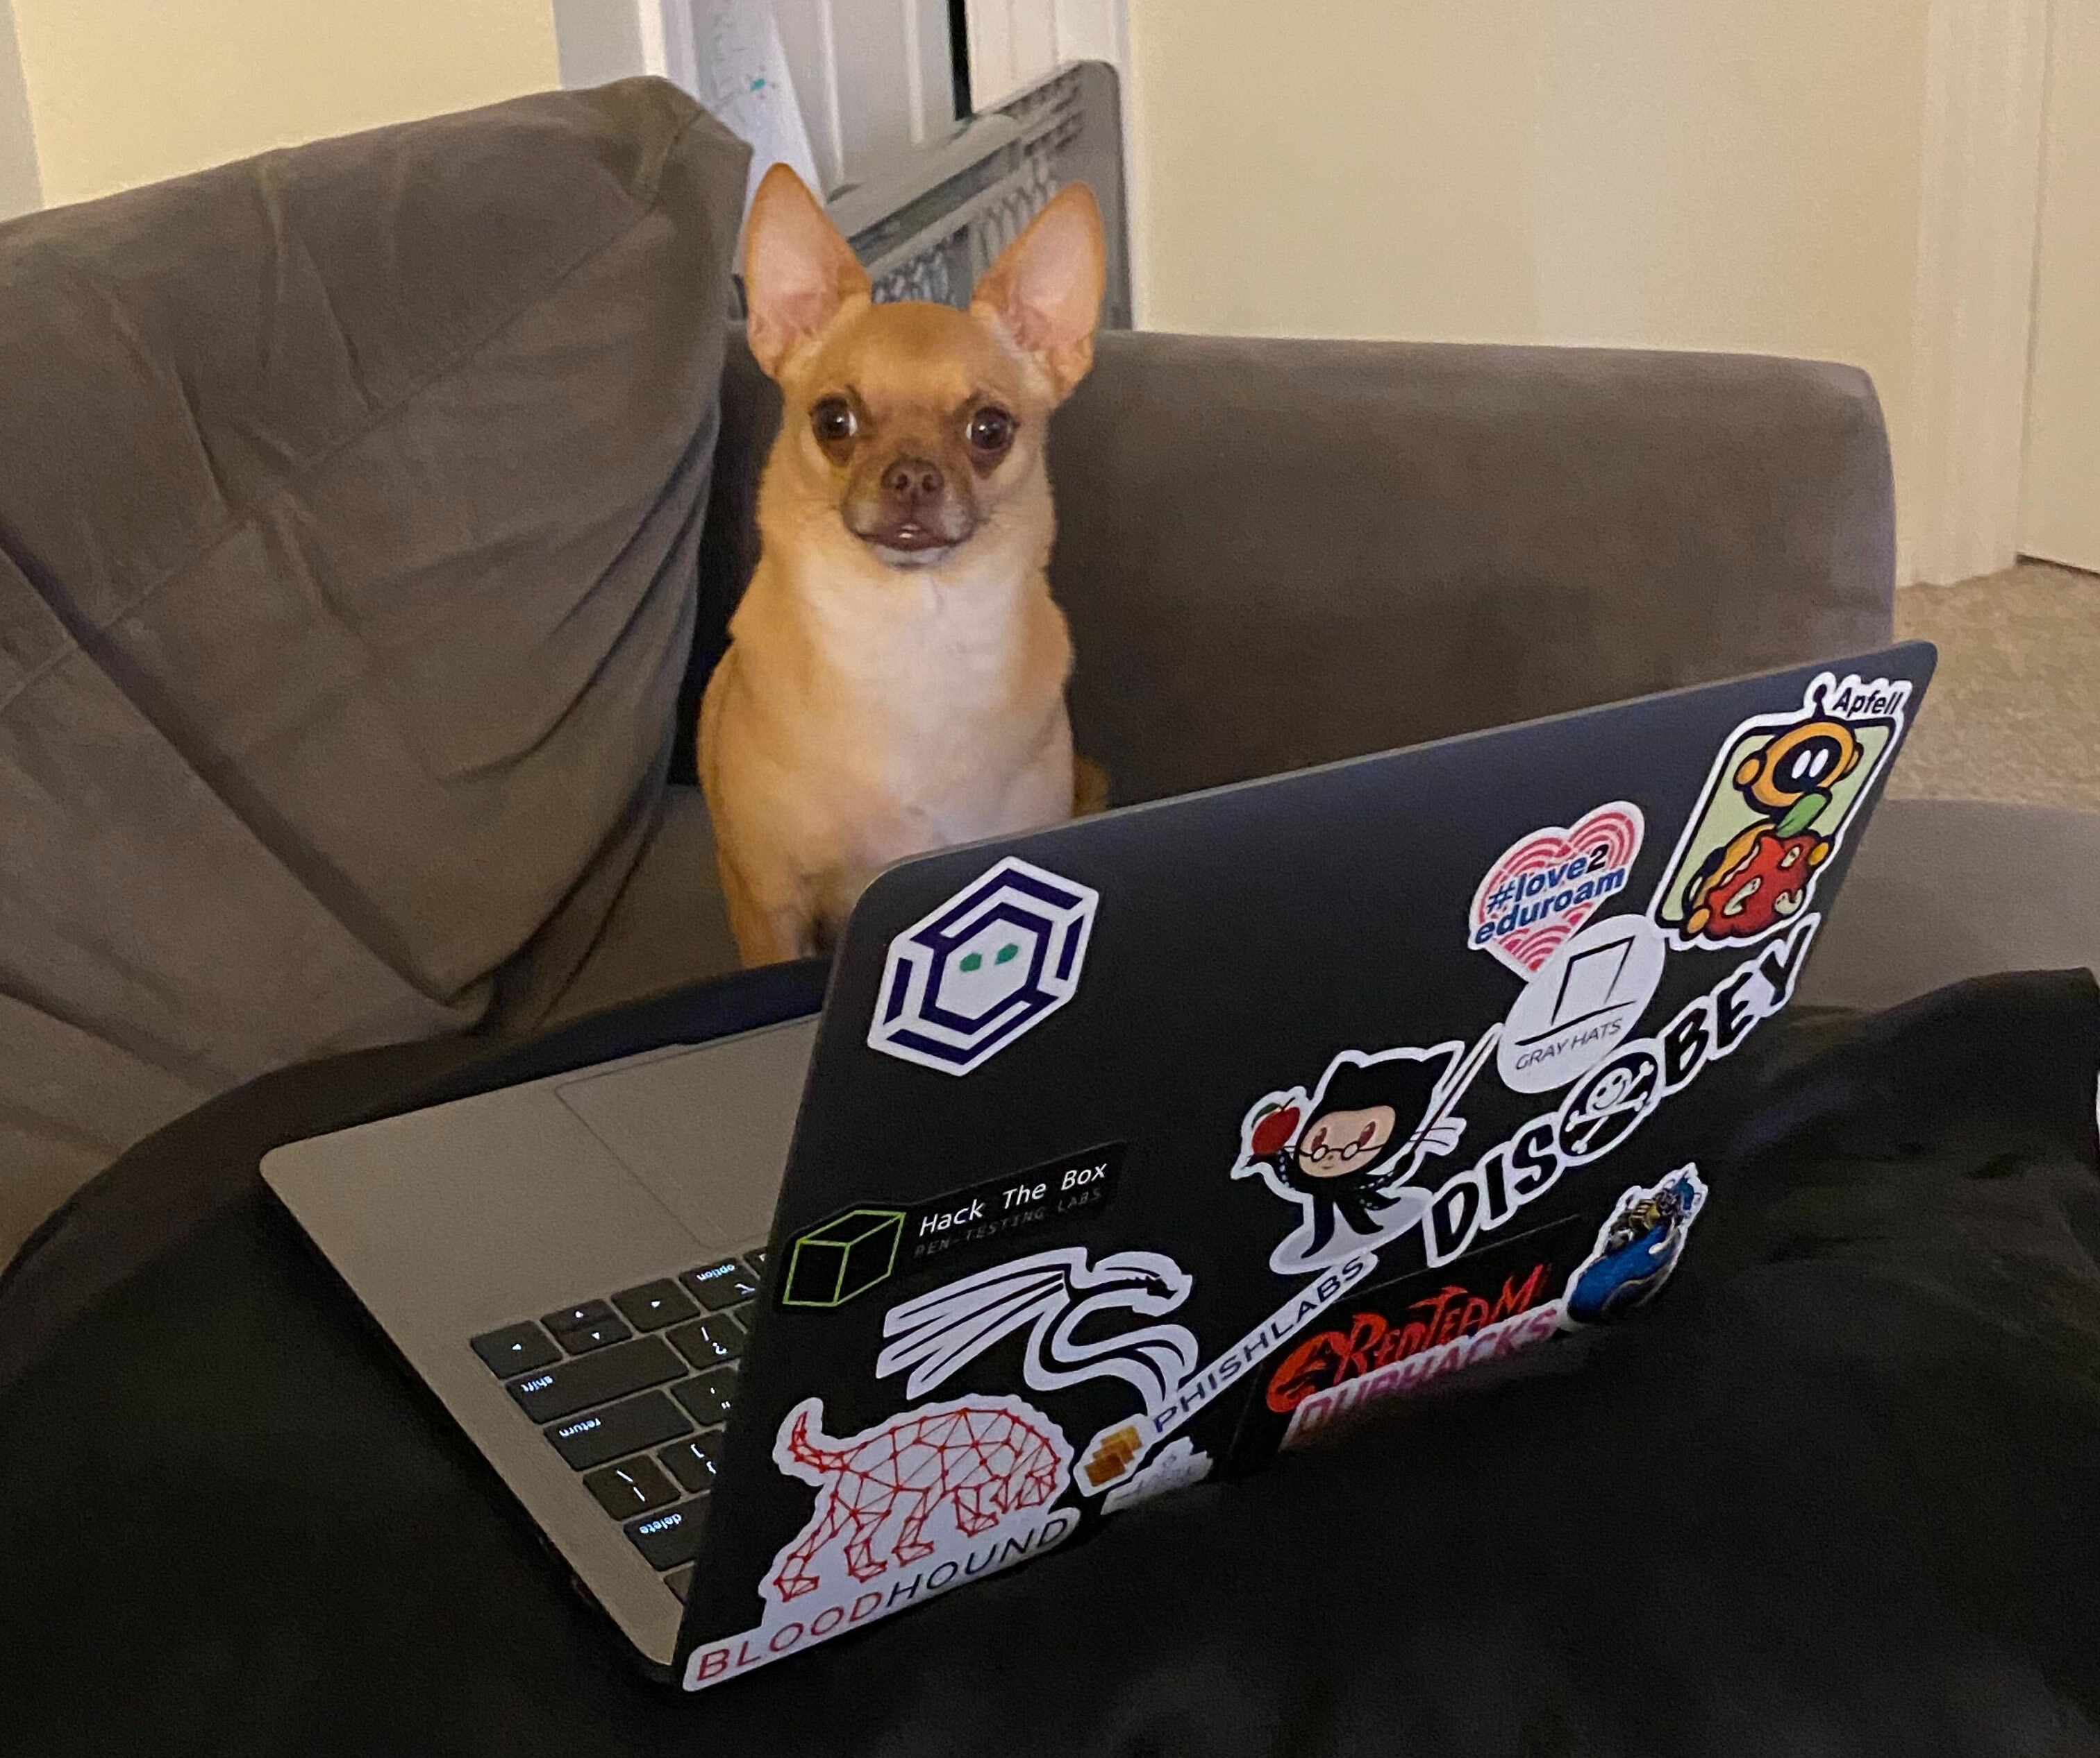
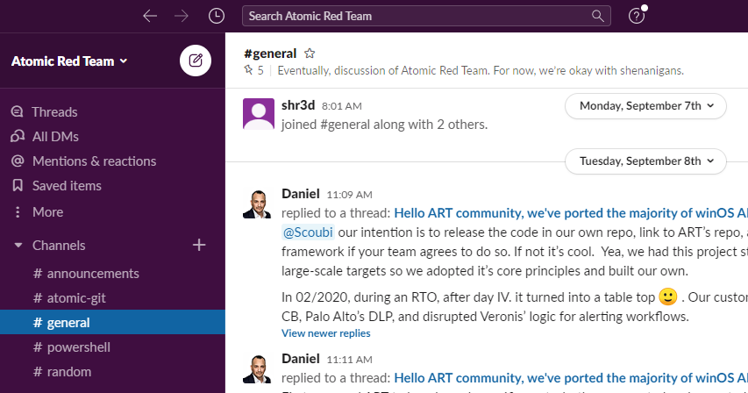
How do I get started?
join the community on Slack https://atomicredteam.slack.com
Notes:
Join the community on Slack at https://atomicredteam.slack.com

Slide 9
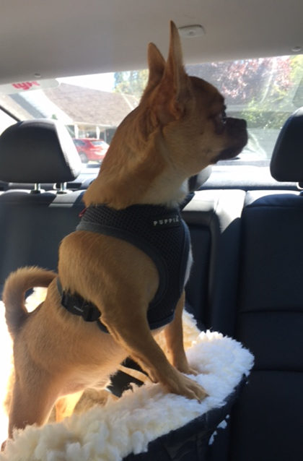
Install Sysmon
Olaf Sysmon-Modular
https://pastebin.com/T9sV27NC
Notes:
Donwloadl Win10 Eval:
https://developer.microsoft.com/en-us/windows/downloads/virtual-machines/
Install SYSMON
Video
https://screencast-o-matic.com/u/vqZ/InstallSysmonOlfa
Olaf Sysmon-Modular
https://pastebin.com/T9sV27NC
Download Sysmon cmds:
Wget
http://live.sysinternals.com/Sysmon64.exe
EXTRA GPO Deployment:
https://github.com/ukncsc/lme/tree/master/Chapter%202%20Files/GPO%20Deployment

Slide 10
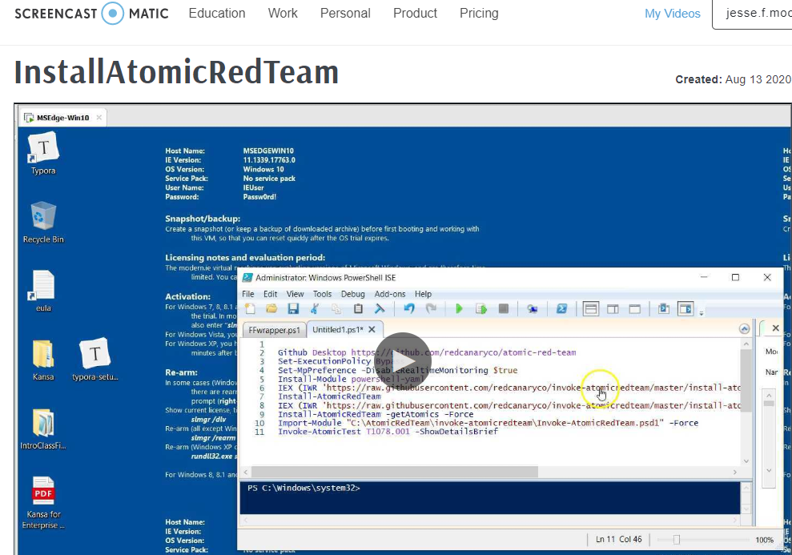
https://screencast-o-matic.com/watch/cYjI0wGBZB
Notes:
Get Win10 VM:
https://developer.microsoft.com/en-us/windows/downloads/virtual-machines/
Install Atomic Red team Pastebin:
https://pastebin.com/ddcnRaf4
Start-AtomicGUI
Invoke-AtomicTest T1110.002 -ShowDetailsBrief Invoke-AtomicTest T1110.002 -CheckPrereqs Invoke-AtomicTest T1110.002 Invoke-AtomicTest T1110.002 –Cleanup
https://screencast-o-matic.com/watch/cYjI0wGBZB
MSFT Win10 Evaluation: https://www.microsoft.com/en-us/evalcenter/evaluate-windows-10-enterprise

Slide 11


DEMO: Adversary Technique
Let do it for realz.
AtomicTest Attack Chain
https://pastebin.com/9vwfaa1P
Notes:
Check Symon after to see artifacts after Invoke-AtomicTest
AtomicTest Attack Chain
https://pastebin.com/9vwfaa1P
Invoke-AtomicTest T1562.002 -TestNames 'Kill Event Log Service Threads' -ShowDetailsBrief
Invoke-AtomicTest T1105 -ShowDetailsBrief
Invoke-AtomicTest T1040 -TestNumbers 4 –ShowDetailsBrief
Invoke-AtomicTest T1078.001 -ShowDetailsBrief
Kill EventLog Service Threads = https://attack.mitre.org/techniques/T1562/002/
LOLB -WinDefend to download file = https://attack.mitre.org/techniques/T1105/
Enable Guest account = https://attack.mitre.org/techniques/T1078/001/
T1040 – Packet Capture: https://github.com/redcanaryco/atomic-red-team/pull/1172
Brute Force: Password Cracking -Hashcat = https://attack.mitre.org/techniques/T1110/002/
Invoke-AtomicTest T1110.002 -ShowDetailsBrief
Defense Evasion:
Recon situational awareness done.
Invoke-AtomicTest T1562.001 -TestName 'Uninstall Sysmon' -ShowDetailsBrief
Invoke-AtomicTest T1562.002 -TestNames 'Kill Event Log Service Threads' -ShowDetailsBrief
Invoke-AtomicTest T1562.001 -TestNames 'Tamper with Windows Defender Command Prompt' -ShowDetailsBrief
Invoke-AtomicTest T1562.001 -TestNames 'AMSI Bypass - AMSI InitFailed' -ShowDetailsBrief

Slide 12
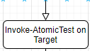
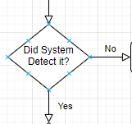
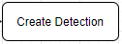
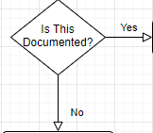
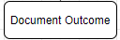
Atomic Red Team Workflow
Monitor EndPoint, Network, Cloud Traffic
Plan
URL, DNS, 445, Linux, Win, Cloud
Invoke-AtomicTest
East to West Traffic Monitored
Continue to next AtomicTest
URL, DNS, 445, Linux, Win, Cloud, FileShares, IAM, 3389, 22, FTP
Notes:
So you want to be a Red Team Hacker, cool lets emulate common TTPS from Mitre ATT&CK
Beyond Secure Configs with benchmarks, Beyond GPO for scale, Its Detection!
(if adversary gets past those, this will see it, hopefully)
Budget, skills friendly...
What to Protect?
Data (Confidential or regulated such as FERPA, PCI, PHI)
Whats at Risk? (Threat and impact if realized)
What do adversaries do? Use Atomic Red Team (Threat Model?)
Plan-Test-Notes-DetectionAlerts-IsitValuable-WhatsMostImpactful
Threat Aware fore Admins (wish I knew what to look for or turn on in the logs) Know whats Events are in Sysmon and why they are triggered
Detection such as Sysmon (AuditD)will get you a long way, don't count on Win defaults
Create a Data wiki to note improvements and relationships to events (Attacks (TTP) with Detection methods) Mordor does this.
Be Better Today than Yesterday!
https://github.com/OTRF/mordor
https://github.com/OTRF/mordor/tree/master/datasets/small/windows/credential_access/host
Use Sigma to hunt
https://www.nextron-systems.com/2018/02/10/write-sigma-rules/
sccm: account, source IP, folders, and default commands at times.
search cmd line... search multiple fields and queries at once, will make Kibana sad
https://strontic.github.io/
Mandiant IOC editor
https://lolbas-project.github.io/

Slide 13
Document???
https://mitre-attack.github.io/attack-navigator/enterprise/
Data Wiki:
https://github.com/sbousseaden/EVTX-ATTACK-SAMPLES
Framework
https://www.cisecurity.org/controls/cis-controls-implementation-groups/

Slide 14
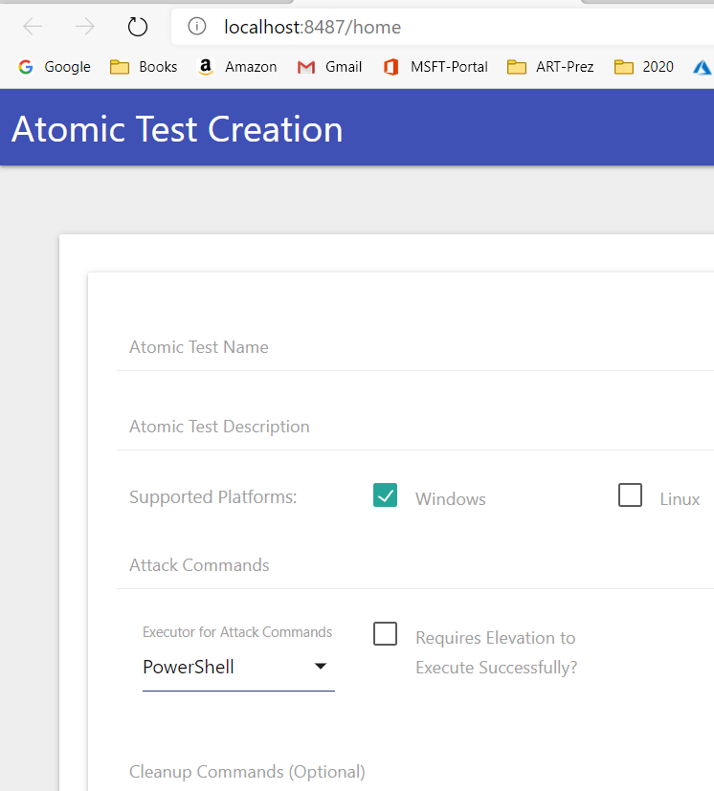
How to create Atomic? Demo time
Start-AtomicGUI
Enable Guest account
https://attack.mitre.org/techniques/T1078/001/
ART REPO T1078
Notes:
Start-AtomicGUI
Go to ART github and FIND/SEARCH for T1078
https://github.com/redcanaryco/atomic-red-team/blob/a97f3f7e3a1d16e5e174b4132bb0fe5b7aa5ae87/atomics/T1078.001/T1078.001.yaml
AtomicTest Attack Chain
https://pastebin.com/9vwfaa1P

Slide 15
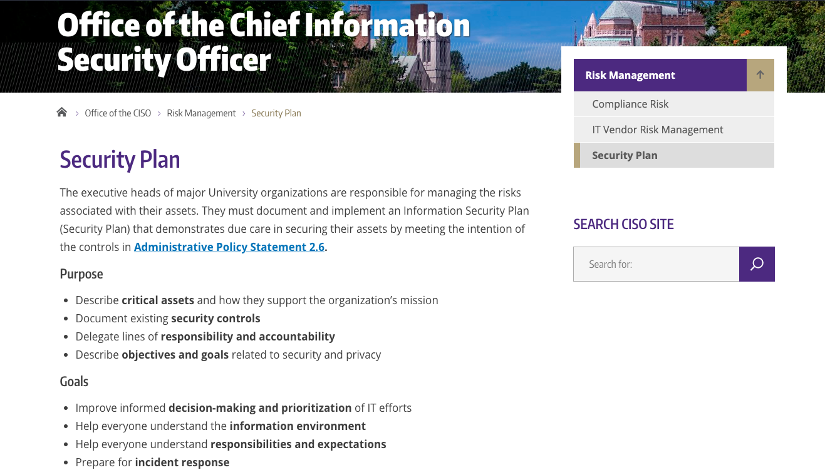
Security Plan?

Slide 16
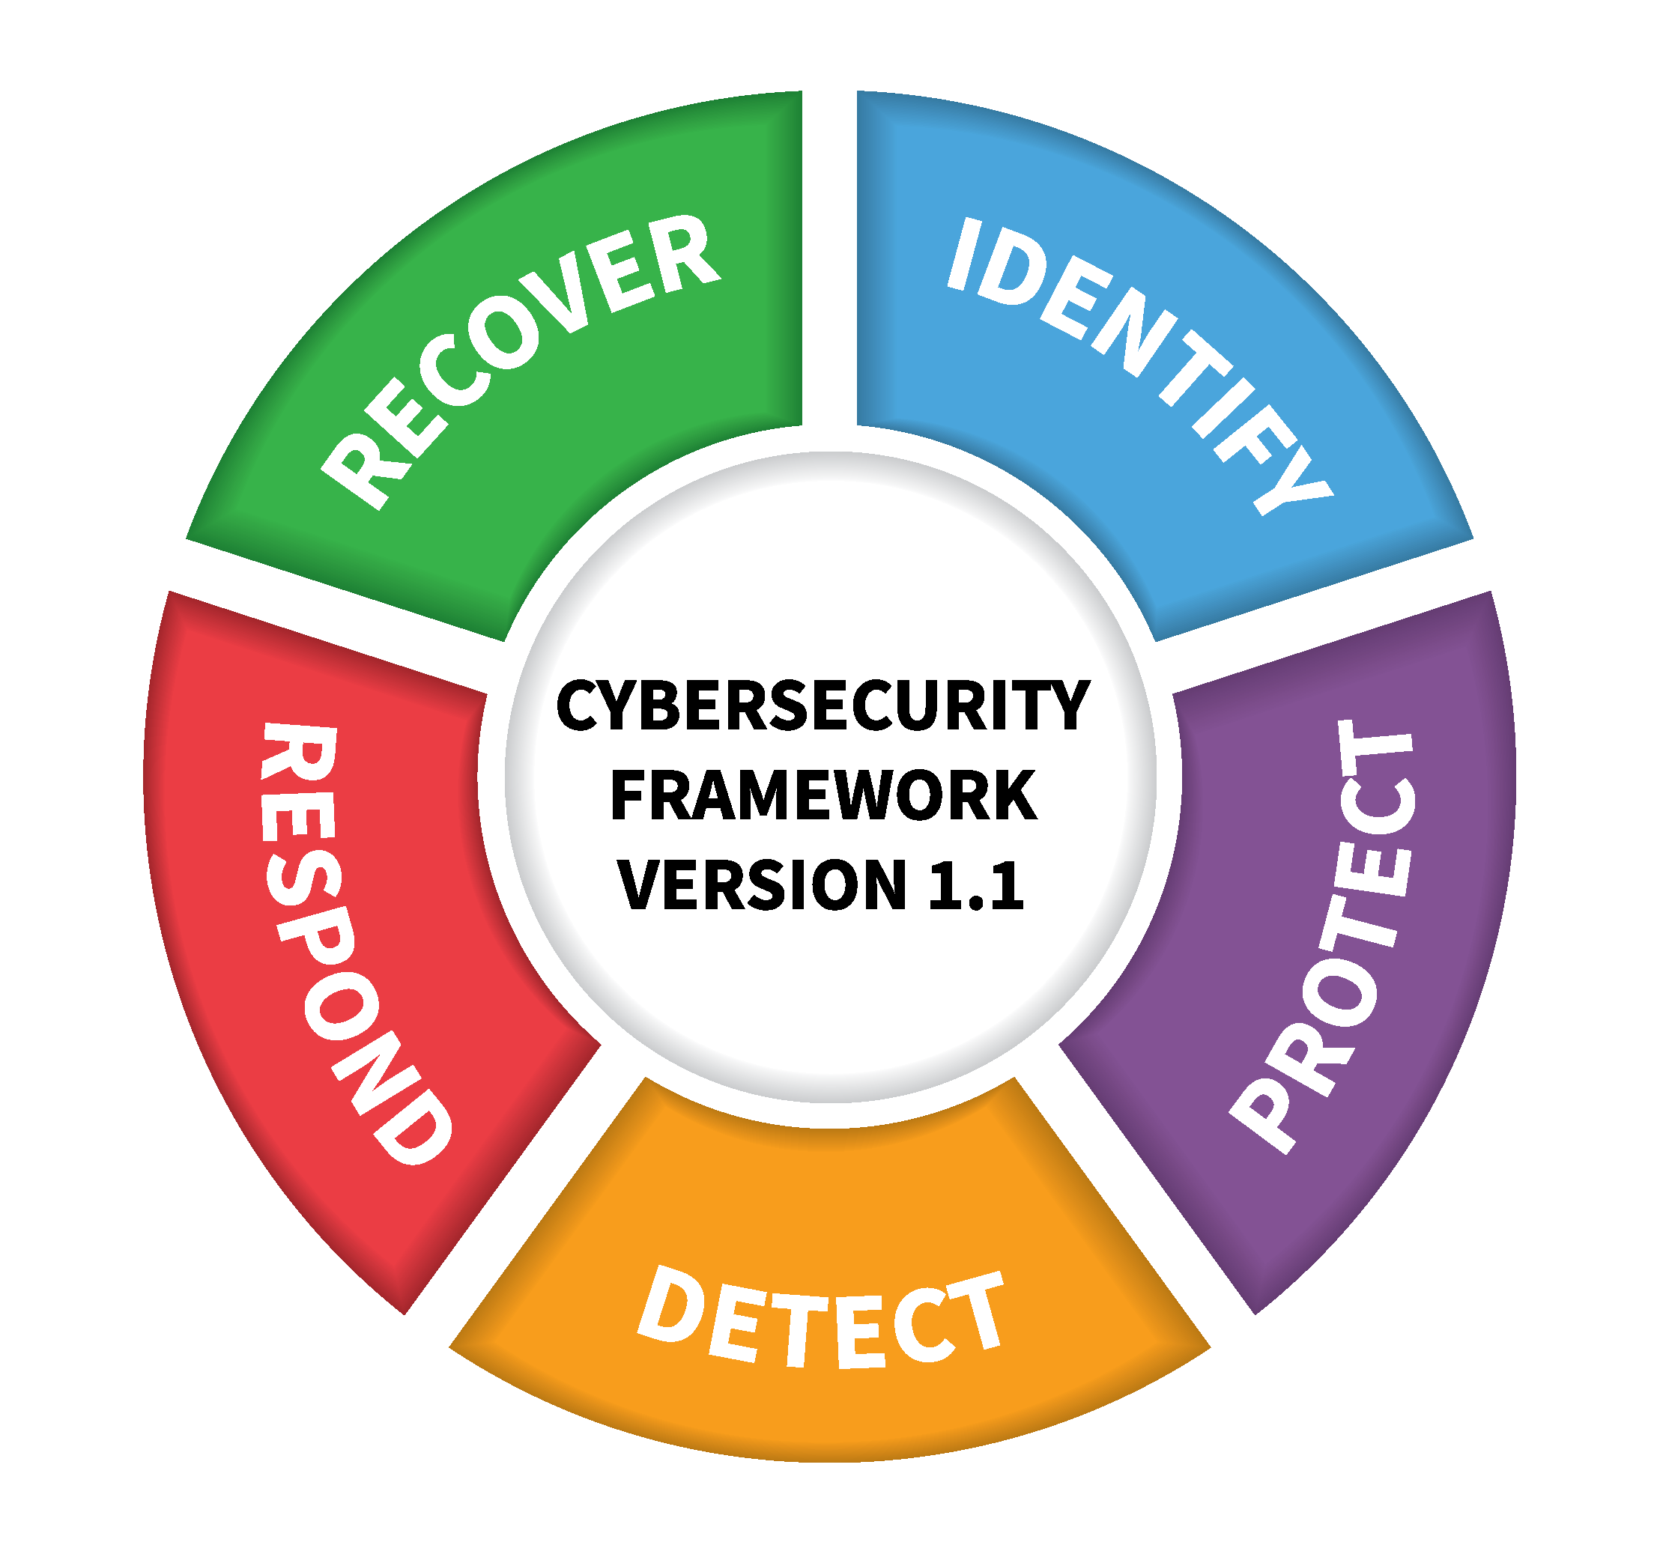
Frameworks?? CSF

Slide 17
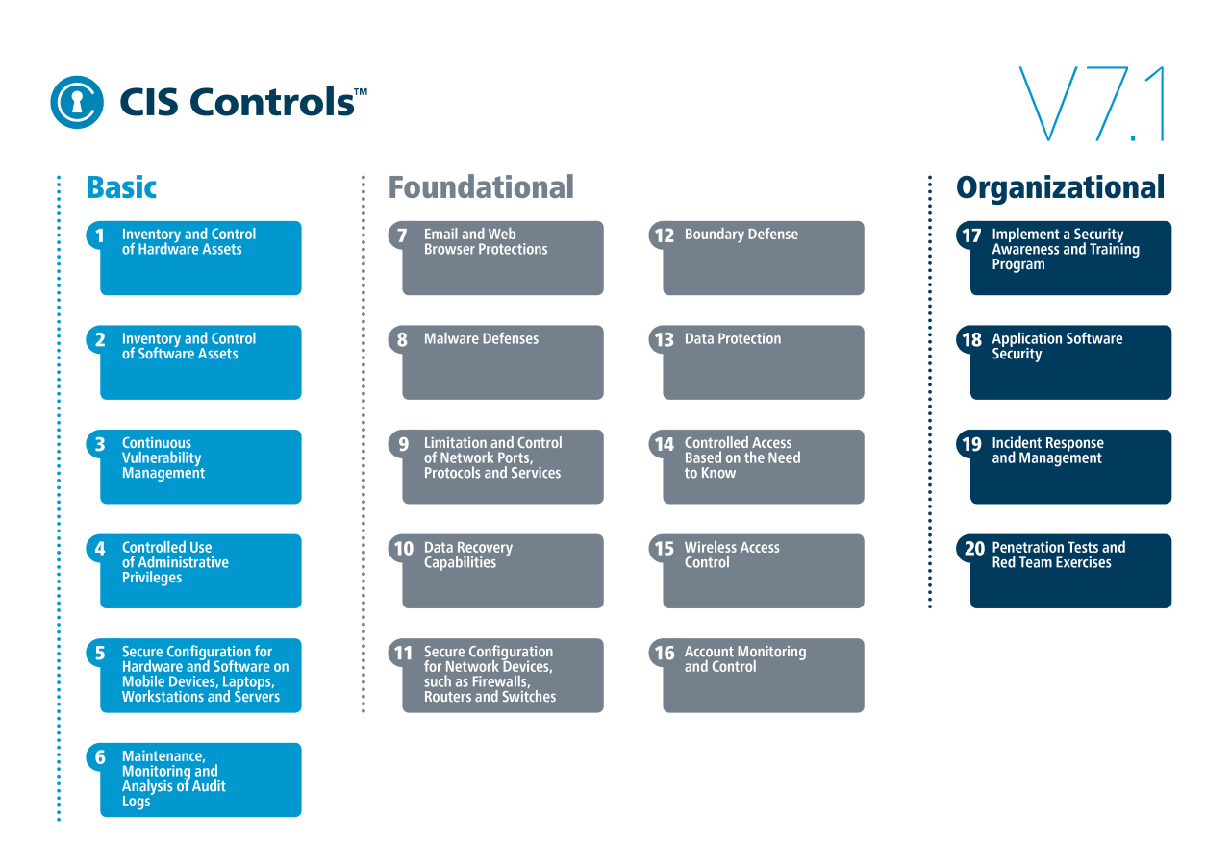
https://www.cisecurity.org/controls/cis-controls-list/
Notes:
https://www.cisecurity.org/controls/cis-controls-list/
6. Maintenance, Monitoring and Analysis of Audit Logs (Log and monitor activity for malicious activity)
16. Account Monitoring and Control (Log and monitor activity for malicious activity)
20. Penetration Tests and Red Team Exercises (Test assumptions or obtain awareness)
19. Incident Response and Management (After investigation some Security things become tasks)
10. Data Recovery Capabilities (Ransomware)
12. Boundary Defense (exfiltration or access)
13. Data Protection (encrypted data)
5. Secure Configuration for Hardware and Software on Mobile Devices, Laptops, Workstations and Servers (Securing via Benchmarks, Vendor recommendations)
3. Continuous Vulnerability Management (Applocker, Windows Update For Business, GPOs, Benchmarks, Alerts for US-CISA, WordpressDB, etc)

Slide 18
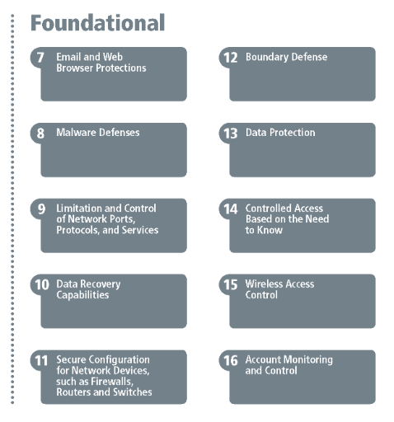
https://www.cisecurity.org/controls/cis-controls-list/
Notes:
https://www.cisecurity.org/controls/cis-controls-list/
6. Maintenance, Monitoring and Analysis of Audit Logs (Log and monitor activity for malicious activity)
16. Account Monitoring and Control (Log and monitor activity for malicious activity)
20. Penetration Tests and Red Team Exercises (Test assumptions or obtain awareness)
19. Incident Response and Management (After investigation some Security things become tasks)
10. Data Recovery Capabilities (Ransomware)
12. Boundary Defense (exfiltration or access)
13. Data Protection (encrypted data)
5. Secure Configuration for Hardware and Software on Mobile Devices, Laptops, Workstations and Servers (Securing via Benchmarks, Vendor recommendations)
3. Continuous Vulnerability Management (Applocker, Windows Update For Business, GPOs, Benchmarks, Alerts for US-CISA, WordpressDB, etc)

Slide 19
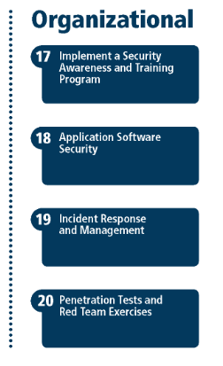
https://www.cisecurity.org/controls/cis-controls-list/
Notes:
https://www.cisecurity.org/controls/cis-controls-list/
6. Maintenance, Monitoring and Analysis of Audit Logs (Log and monitor activity for malicious activity)
16. Account Monitoring and Control (Log and monitor activity for malicious activity)
20. Penetration Tests and Red Team Exercises (Test assumptions or obtain awareness)
19. Incident Response and Management (After investigation some Security things become tasks)
10. Data Recovery Capabilities (Ransomware)
12. Boundary Defense (exfiltration or access)
13. Data Protection (encrypted data)
5. Secure Configuration for Hardware and Software on Mobile Devices, Laptops, Workstations and Servers (Securing via Benchmarks, Vendor recommendations)
3. Continuous Vulnerability Management (Applocker, Windows Update For Business, GPOs, Benchmarks, Alerts for US-CISA, WordpressDB, etc)

Slide 20
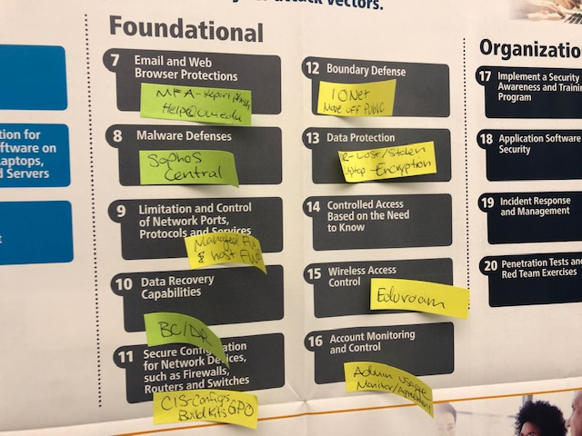

Slide 21
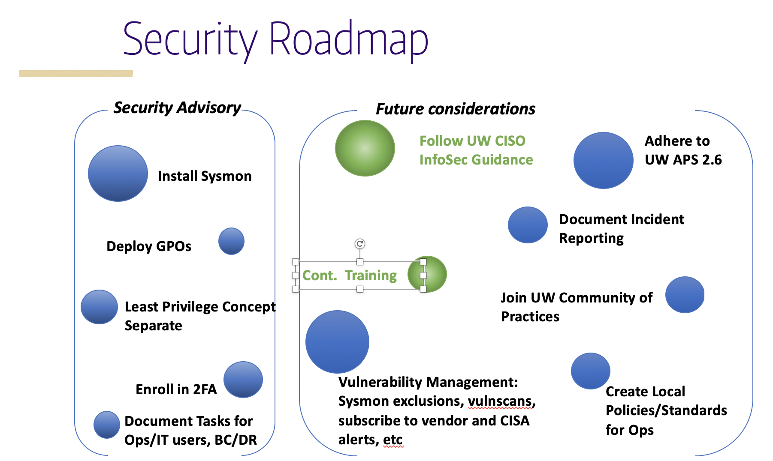

Slide 22
Scenario based:
6. Maintenance, Monitoring and Analysis of Audit Logs (Log and monitor activity for malicious activity)
16. Account Monitoring and Control (Log and monitor activity for malicious activity)
20. Penetration Tests and Red Team Exercises (Test assumptions or obtain awareness)
19. Incident Response and Management (After investigation some Security things become tasks)
10. Data Recovery Capabilities (Ransomware)
12. Boundary Defense (exfiltration or access)
13. Data Protection (encrypted data)
5. Secure Configuration for Hardware and Software on Mobile Devices, Laptops, Workstations and Servers (Securing via Benchmarks, Vendor recommendations)
3. Continuous Vulnerability Management (Applocker, Windows Update For Business, GPOs, auto update 3rd party apps, Benchmarks, Alerts for US-CISA, WordpressDB, etc)
https://www.cisecurity.org/controls/cis-controls-list/
Notes:
https://www.cisecurity.org/controls/cis-controls-list/
6. Maintenance, Monitoring and Analysis of Audit Logs (Log and monitor activity for malicious activity)
16. Account Monitoring and Control (Log and monitor activity for malicious activity)
20. Penetration Tests and Red Team Exercises (Test assumptions or obtain awareness)
19. Incident Response and Management (After investigation some Security things become tasks)
10. Data Recovery Capabilities (Ransomware)
12. Boundary Defense (exfiltration or access)
13. Data Protection (encrypted data)
5. Secure Configuration for Hardware and Software on Mobile Devices, Laptops, Workstations and Servers (Securing via Benchmarks, Vendor recommendations)
3. Continuous Vulnerability Management (Applocker, Windows Update For Business, GPOs, Benchmarks, Alerts for US-CISA, WordpressDB, etc)

Slide 23

The End… Call to Action!
¯\_(ツ)_/¯
1. Plan to Protect and Defend
2. Test assumptions with Atomic Red Team & ensure Detections
Notes:
Protect & Defend: 0365 Microsoft Threat Protection

Slide 24
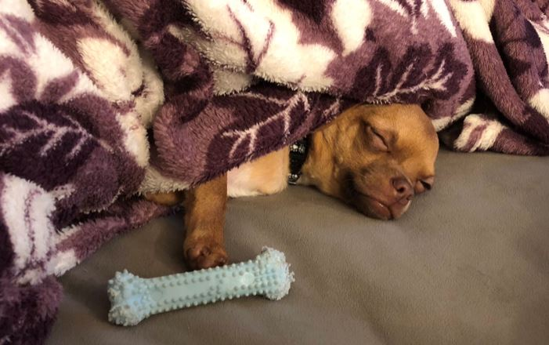
Yep, that was fun…
Contact info:
Twitter: @jessefmoore
https://www.linkedin.com/in/jessefmoore/
Download resources here:
http://bit.ly/AtomicRedTeam

